Slide 1
Citizen-Centric Budgeting
Presentation for
Virginia Municipal League
October 2018

Slide 2
Our Presenters
Ann Ebberts, CEO, Association of Government Accountants
David Meyer, Mayor, Fairfax City
Michael DeMarco, Council Member, Fairfax City
Melanie Crowder, City Clerk, Fairfax City
Jennifer Passey, Council Member, Fairfax City
Jon Stehle, Council Member, Fairfax City

Slide 3
^{AGA is the member} ^{organization for} financial professionals in government
We lead and encourage change that benefits our field and all citizens. Networking events, professional certification, publications and ongoing education help our members build their skills and advance their careers.

Slide 4
Where Do Our Members Work?
AGA is the only association supporting approximately 15,000 government financial professionals working in federal, state and local governments as well as the private, nonprofit and academic sectors
31%
Federal government
31%
State government
12%
Local government
16%
Private sector
10%
Academia, students, nonprofits and retirees

Slide 5
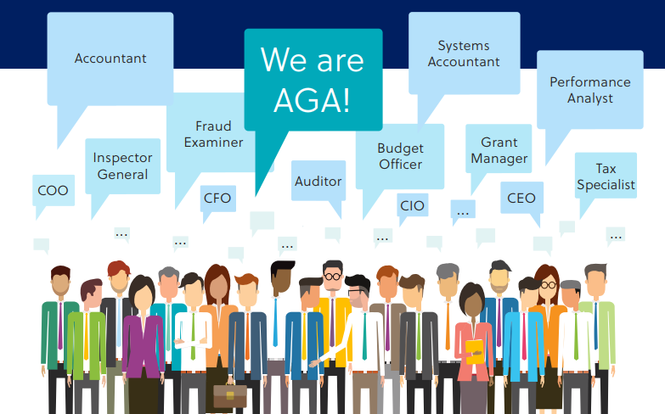
From undergraduate students to government executives and industry experts, . . . we are all . . . AGA!

Slide 6
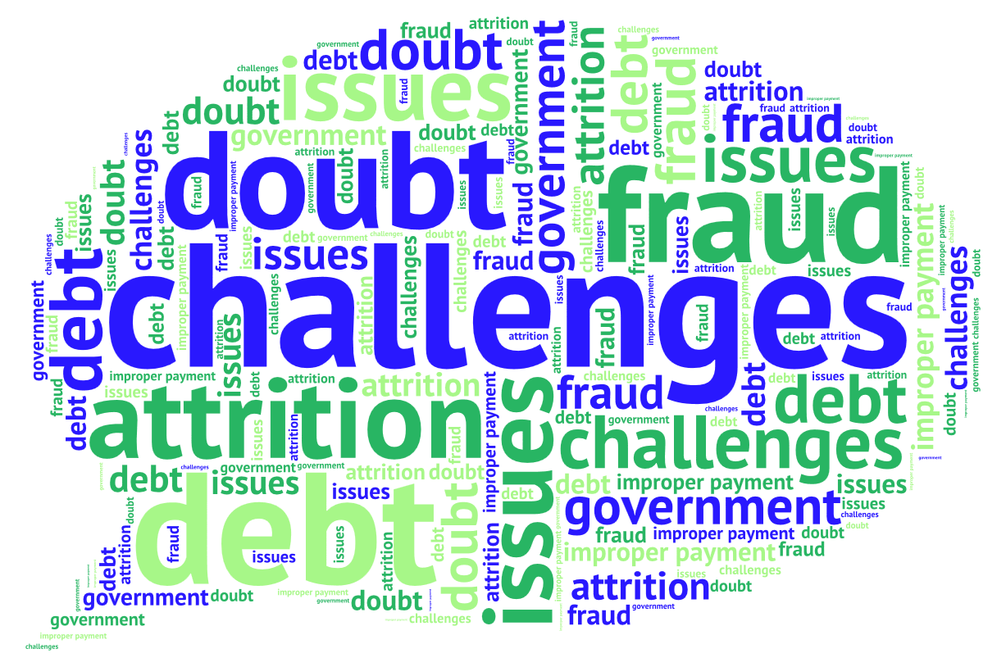
Public Sentiment
Public opinion of government is mixed
Citizens can’t find reliable information
“How much money is being spent?
“What are we getting for our tax dollars?”
“Why are my taxes increasing?”
Press focuses on challenges, rather than achievements
Government financial reports are hard to understand

Slide 7
Citizen-Centric Reporting (CCR) – since 1997!
Fostering innovative means of communication between governments and their citizenry
“A government’s obligation to the people for its actions and use of resources”
- AGA’s definition of accountability
“Giving the citizens numbers they can understand.”
-Governing
. . . Making annual financial reports available to the public -- is a first step. The CCR provides a next logical step to informing our citizens.

Slide 8
Government Finance Case Challenge
Undergraduate and graduate students compete in the virtual Government Finance Case Challenge
Two Yearly Competitions -- Deadlines for students to apply:
Fall 2018: Sept 21, 2018, noon ET
Spring 2019: Feb 15, 2019, noon ET
Submissions judged by a panel of government finance experts (AGA members, Staff, agency members) -- top teams present findings via video
Winning team members are each awarded $1000 scholarship – funded by AGA
Notes:
NOTE …
The next couple of slides identify what the last winning team developed in the Government case challenge
Useful to show students what the “deliverable product is”

Slide 9
Government Finance Case Challenge
AGA’s Role:
Coordinate and fund the program
We identify a “target government entity”
Conduct outreach to our academic members as well as other colleges and universities
College/University Role:
Form a 3-student team (plus a Faculty advisor) to provide value to a government entity; submit an application
Analyze data within a two week period, for a specified U.S. state, city or county government and develop a Citizen-Centric Report (CCR).
Students learn about government services, data availability, and what’s important to communicate to citizens
Notes:
NOTE …
The next couple of slides identify what the last winning team developed in the Government case challenge
Useful to show students what the “deliverable product is”

Slide 10
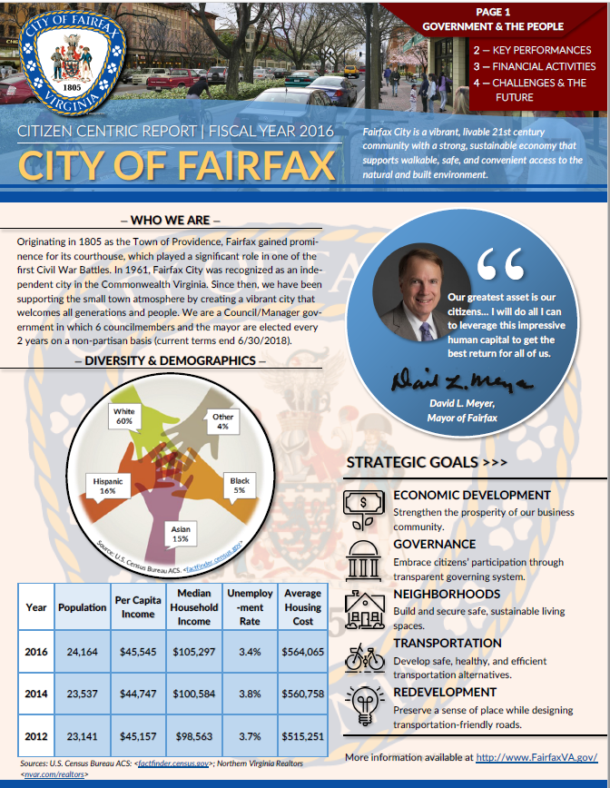
CCR: Page 1
Vision Statement
Basic demographics
Strategic goals and accomplishments
This CCR was created by AGA’s 2017 Government Case Challenge winning team –
NC State University!

Slide 11
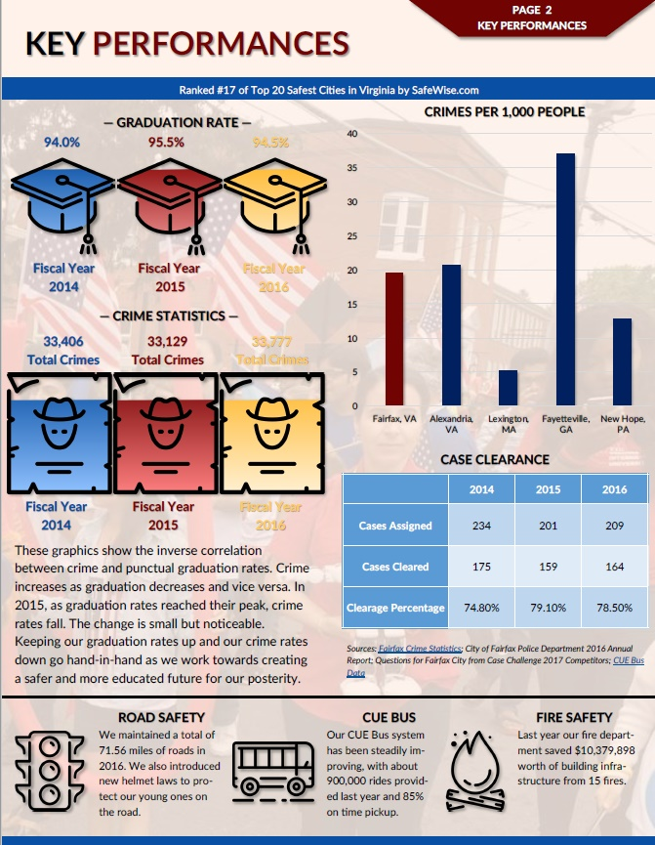
CCR: Page 2
Key service areas
Progress toward strategic goals or deliverables
Demonstration of accomplishments (2-5 years) for non-financial outcomes

Slide 12
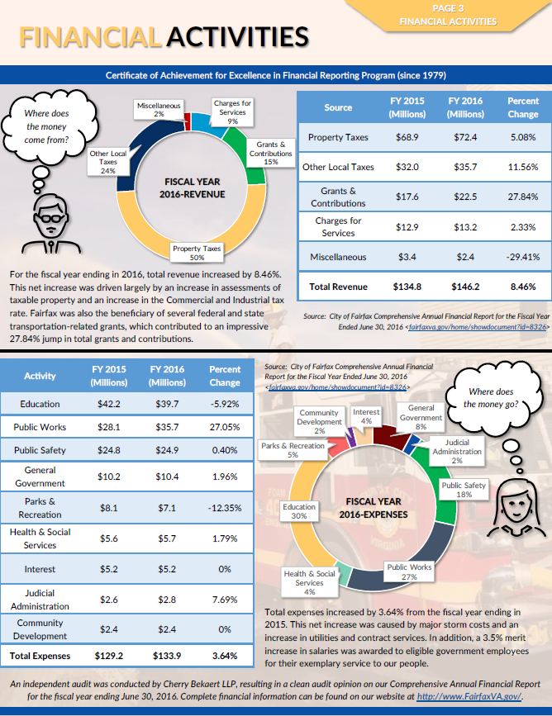
CCR: Page 3
Revenue and cost data for major delivery areas
Well-labeled charts, graphs and tables
Reference audit conducted
Provide URL for more detailed financial information

Slide 13
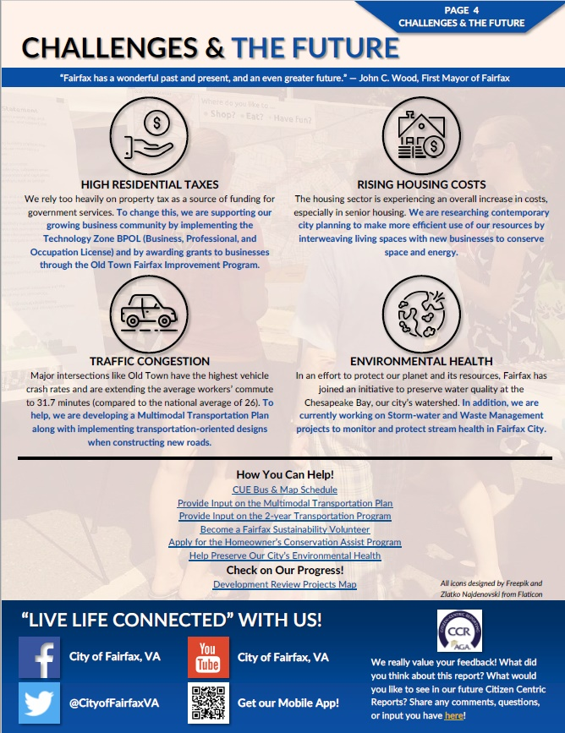
CCR: Page 4
Challenges, moving forward:
Economic changes
Tax cuts or increases
Unemployment
Education
Environmental aspects
Ask for feedback

Slide 14
Benefits to Your State, City, or County:
Target City Role:
Work with AGA to identify data files to make available
Participate in judging submissions
Benefits for Target City:
Receive an “external and objective” view of how you are currently presenting your information
Leverage different approaches to communicate with citizens about information that matters to them
“Free” consulting efforts – students, AGA members, Agency staff
Jump start your efforts to develop a new citizen communication approach -- and receive “free press” in the process
Notes:
NOTE …
The next couple of slides identify what the last winning team developed in the Government case challenge
Useful to show students what the “deliverable product is”

Slide 15
Send Your Citizen Centric Report to AGA
Send your CCR to AGA at ccr@agacgfm.org – at any time during the year
AGA’s team will review your submission and provide constructive feedback so your CCR will be more impactful
We send you a letter outlining notable aspects, as well as areas that could be “more informative”
We recognize well designed and informative CCRs with an AGA Certificate of Excellence
We post the CCRs on our Website
Want to be our next “target city”?
Notes:
NOTE …
The next couple of slides identify what the last winning team developed in the Government case challenge
Useful to show students what the “deliverable product is”

Slide 16
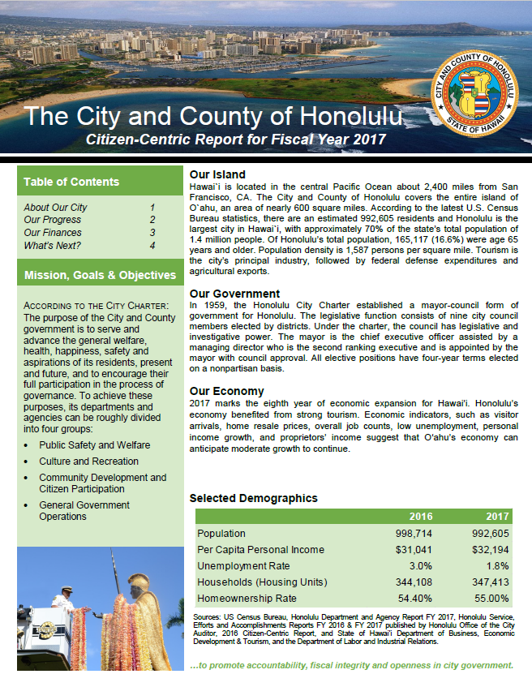
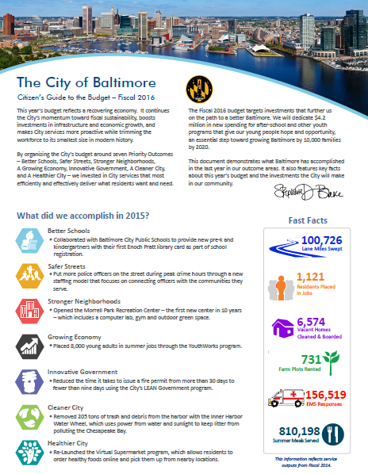
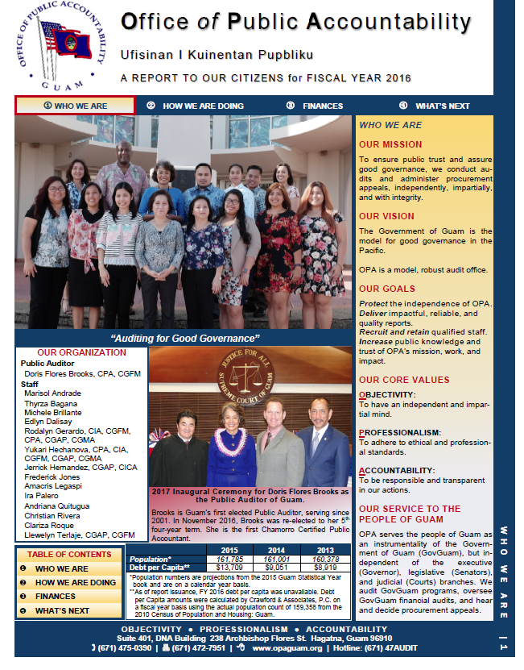
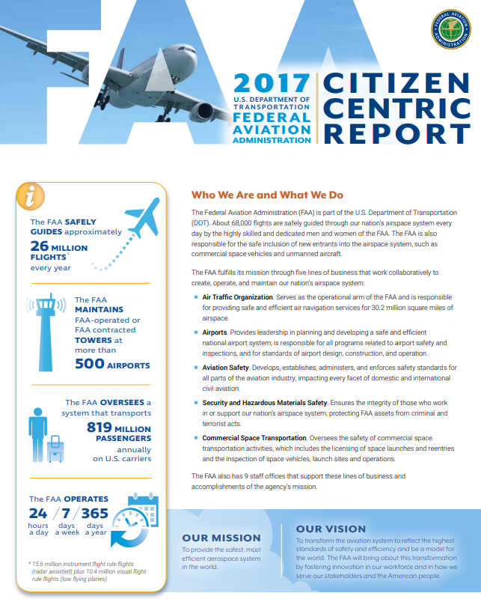
Examples of Government Entities that Create CCRs
City/County of Honolulu
City of Baltimore, MD
Guam, Office of Public Accountability
Dept of Homeland Security
Federal Aviation Administration

Slide 17
Do you want to be a Case Challenge “Target City”? Contact me at aebberts@agacgfm.org or ccr@agacgfm.org Check out our website: www.agacgfm.org

