Slide 1
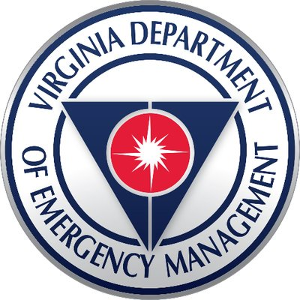
Elected and Public Officials Roles and
Responsibilities During
a Disaster
Virginia Department of
Emergency Management
Notes:
My name is Shannon Daniel and I work for VDEM as the Training Manager and I am your State Training Officer. I have been involved in Emergency Management for about 10 years and a first responder for 23. I am in the final stages of obtaining my PhD in Adult Education Leadership.

Slide 2
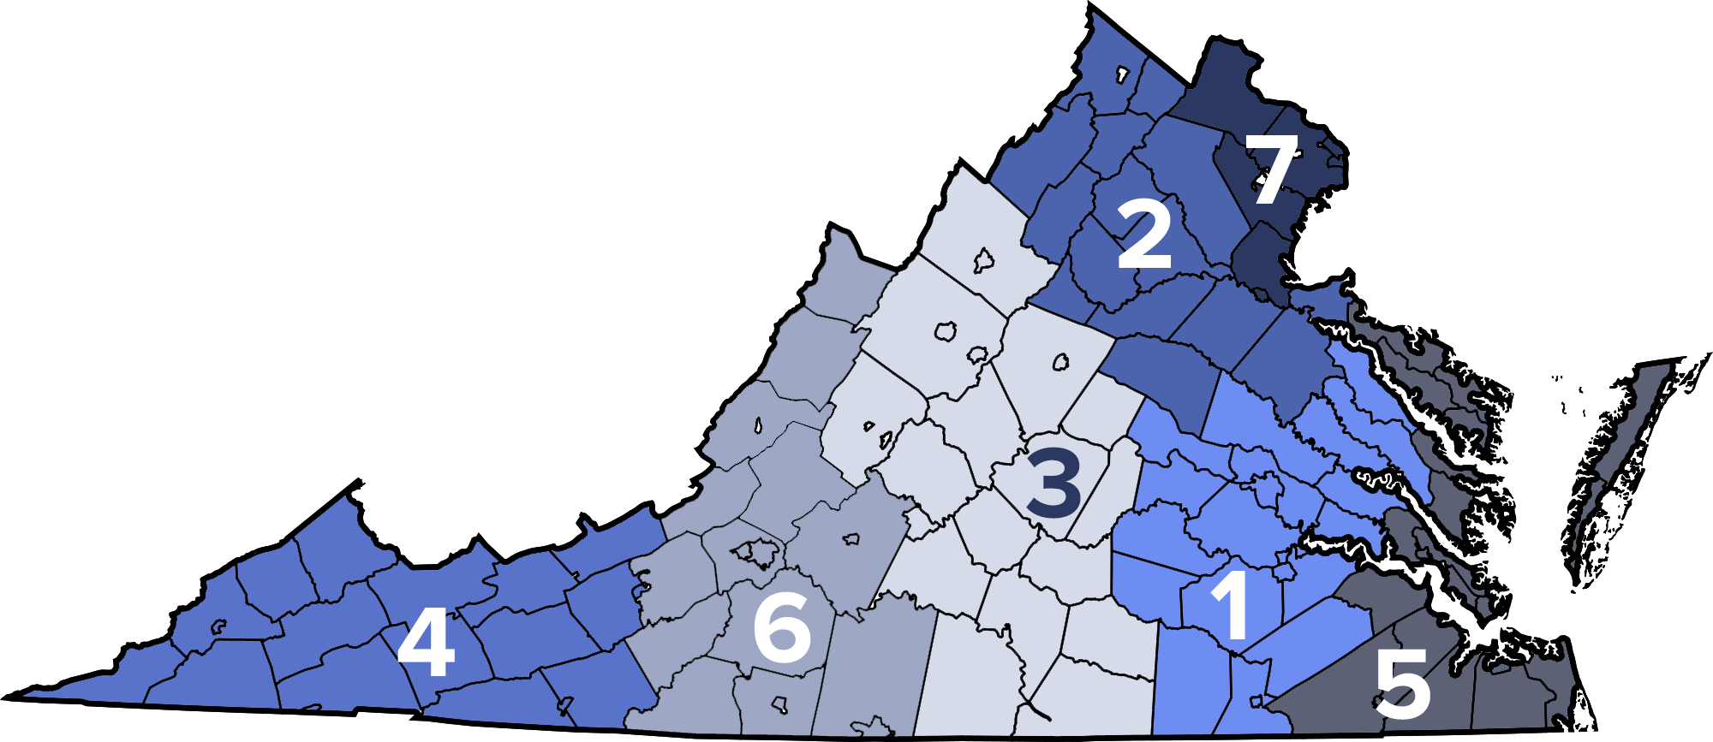
Commonwealth of Virginia
Notes:
We are part of FEMA Region 3 which includes Delaware, Maryland, Commonwealth of Pennsylvania, West Virginia and Commonwealth of Virginia
VDEM is located in North Chesterfield
Our EOC is located in Virginia State Police headquarters in Chesterfield
We have 139 jurisdictions within our 7 regions throughout the Commonwealth
Region 1 is the Richmond Area, Goochland and Hanover down to Greensville
Region 2 is Louisa, Caroline all the way up to Frederick, VA
Region 3 Rockingham down to Mecklenburg, Halifax and South Boston
Region 4 is the southwest to Lee County, Radford is on the line
Region 5 is Southampton, Williamsburg area, Westmoreland all the way out to Accomack County to include Tangier
Region 6 is Roanoke Area to include Highland down to Danville
Region 7 is Northern Virginia area which is Stafford to Loudoun

Slide 3
Virginia Disaster and Emergency Management Laws
Code of Virginia (44-146.19)
Each political subdivision within the Commonwealth shall be within the jurisdiction of and served by the Department of Emergency Management and be responsible for local disaster mitigation, preparedness, response and recovery. Each political subdivision shall maintain in accordance with state disaster preparedness plans and programs an agency of emergency management...
https://law.lis.virginia.gov/vacode
Notes:
All emergencies begin and end at the local level.
Emergency management organizations in towns are usually integrated into county government, unless specified by charter.
Towns shall appoint a coordinator of emergency management to ensure integration into their county’s emergency management organization.
Each political subdivision shall have a director of emergency management.
Each political subdivision shall have an agency of emergency management, which has jurisdiction over the entire political subdivision.
The local director of emergency management or a designee may declare a local emergency with the consent of the governing body of the political subdivision.
If the governing body cannot convene, the director, or designee, or in the absence of both, any member of the governing body may declare a local emergency, subject to confirmation by the governing body at its next regularly scheduled meeting (or at a special meeting within 14 days of the declaration, whichever occurs first).

Slide 4
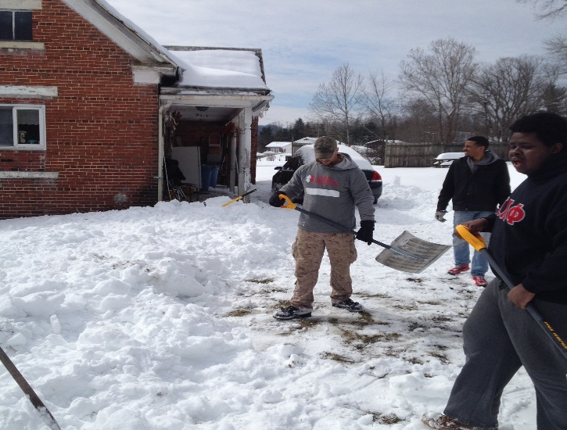
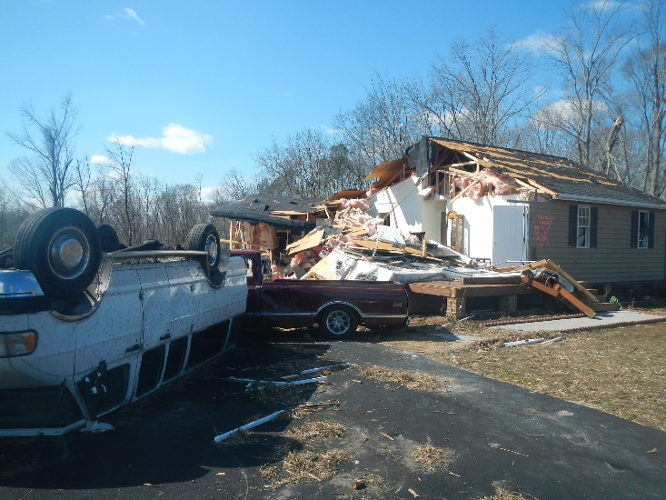
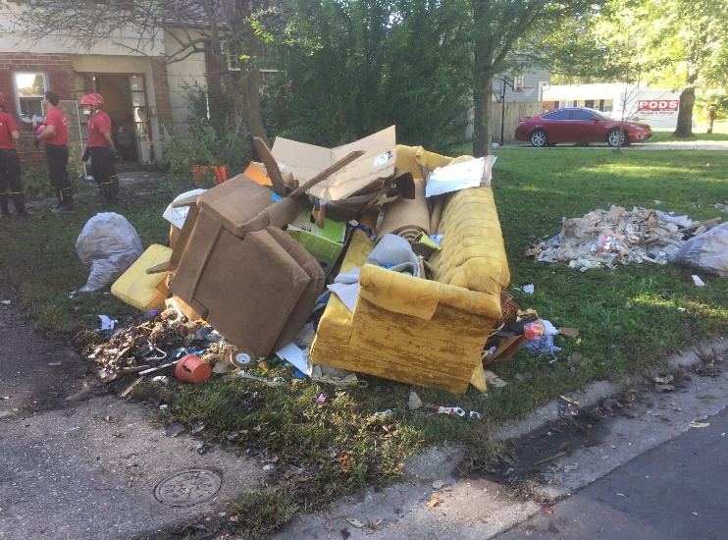
The Impact
As elected and public officials, your response to a disaster will influence government, citizens, the private sector, voluntary organizations and the media.
Notes:
VDEM is the lead agency at the state level that protects the lives and property of Virginia’s citizens from emergencies and disasters by coordinating the state’s prevention, preparedness, mitigation, response, and recovery.
Elected officials have an extremely difficult job. You serve your community, citizens, local governments, and during an emergency you will be called on for information, answers, and decisions to be made quickly and proficiently.
It is so important you develop a working relationship with your public information officer so when sharing information it is consistent and the most current.
One of your main jobs as an elected official is to help manage public expectations about what government can or cannot provide during or after a disaster. Reassure citizens
that responders are doing all they can, but do not raise unrealistic expectations. Knowing your locality’s emergency operation plan will help you more confidently and accurately answer questions.
The first picture is Tappahannock Tornado in 2/2016, the second picture is the snow storm in Wise, VA 2/2015, and the third picture is Hurricane Matthew in VA Beach, 10/16.
Preparation and planning as an elected Official will aid in determining response to the situation.

Slide 5
National Preparedness Goal
Prevention
Protection
Mitigation
Recovery
Response
“A secure and resilient nation with the capabilities required across the whole community to prevent, protect against, mitigate, respond to, and recover from the threats and hazards that pose the greatest risk.”
Notes:
National Preparedness Goal includes but is not limited to risks such as natural disasters, disease pandemics, chemical spills, and other manmade hazards, terrorist attacks and cyber attacks.
The five mission areas:
Prevention: The capabilities necessary to avoid, prevent, or stop a threatened or actual act of terrorism. Within national preparedness, the term “prevention” refers to preventing imminent threats.
Protection: The capabilities necessary to secure the homeland against acts of terrorism and man-made or natural disasters.
Mitigation: The capabilities necessary to reduce loss of life and property by lessening the impact of disasters.
Response: The capabilities necessary to save lives, protect property and the environment, and meet basic human needs after an incident has occurred.
Recovery: The capabilities necessary to assist communities affected by an incident to recover effectively. Recovery includes the restoration and strengthening of key systems and resource assets that are critical to the economic stability, vitality, and long-term sustainability of the communities themselves.
These include health and human services capabilities and networks, public and private disability support and service systems, educational systems, community social networks, natural and cultural resources, affordable and accessible housing, infrastructure systems, and local and regional economic drivers.

Slide 6
Preparedness
Understand the National Incident Management System
Get involved with your local Emergency Operations plan
Participate in training and exercise
Encourage Community and business preparedness
Notes:
NIMS
DHS created NIMS to provide a comprehensive and consistent approach to incident management.
Be applicable across a full spectrum of potential incidents, hazards, and impacts, regardless of size, location or complexity.
• Improve coordination and cooperation between public and private entities in a variety of incident management activities.
• Provide a common standard for overall incident management.
Preparedness
Communications and Information Management
Resource Management
• Command and Management
• Ongoing Management and Maintenance
Emergency Operations Plans
The Code of Virginia requires each jurisdiction to maintain and keep current an Emergency Operation Plan.
Know your plan and be involved with updates.
Your involvement will send a strong message to agencies and departments about the importance of this plan and preparedness, you should make this a priority as elected officials.
Training and Exercise is what can test the plan prior to using it is a real-life disaster.
There are several outlets available to assist in training.
Emergency Management Institute and VDEM offer online and classroom classes on these topics.
Statewide and regional exercises are conducted regularly and local participation is an opportunity to practice your EOP.
Community and Business Preparedness
Emergency responders will respond quickly, but cannot reach everyone right away.
All citizens should be self sufficient for at least 72 hours after a disaster.
Visit ReadyVirginia.gov for more information about how to prepare.

Slide 7
Prevention
Reporting Suspicious Activity
To report suspicious activity please contact your local law enforcement. Describe specifically what you observed, including:
Who or what you saw;
When you saw it;
Where it occurred; and
Why it's suspicious.
If there is an emergency, call 9–1–1.
Notes:
Prevention: The capabilities necessary to avoid, prevent, or stop a threatened or actual act of terrorism. Within national preparedness, the term “prevention” refers to preventing imminent threats.
Prevent, avoid or stop an imminent, threatened or actual act of terrorism.
"If You See Something, Say Something®" engages the public in protecting our homeland through awareness-building, partnerships, and other outreach.
Terrorist tactics continue to evolve, and we must keep pace. Terrorists seek sophisticated means of attack, including chemical, biological, radiological, nuclear and explosive weapons, and cyber attacks. Threats may come from abroad or be homegrown.
We must be vigilant against new types of terrorist recruitment as well, by engaging communities at risk being targeted by terrorist recruiters.
Unusual items or situations: A vehicle is parked in an odd location, a package/luggage is unattended, a window/door is open that is usually closed, or other out-of-the-ordinary situations occur.
Eliciting information: A person questions individuals at a level beyond curiosity about a building’s purpose, operations, security procedures and/or personnel, shift changes, etc.
Observation/surveillance: Someone pays unusual attention to facilities or buildings beyond a casual or professional interest. This includes extended loitering without explanation (particularly in concealed locations); unusual, repeated, and/or prolonged observation of a building (e.g., with binoculars or video camera); taking notes or measurements; counting paces; sketching floor plans, etc.

Slide 8
Other Prevention Campaigns
Blue Campaign-
Fight Human Trafficking
#BeCyberSmart
https://www.dhs.gov/stopthebleed
https://www.dhs.gov/
blue-campaign
https://www.dhs.gov/be-cyber-smart
Stop. Think. Connect.
https://www.ready.gov/citizen-corps
https://www.ready.gov/
https://www.dhs.gov/stopthinkconnect
Notes:
Stop the Bleed is a national awareness campaign and call-to-action that encourages the public to train, equip, and empower themselves to help in a bleeding emergency before professional help arrives.
The Blue Campaign is the unified voice for DHS’ efforts to combat human trafficking. Working in collaboration with law enforcement, government, non-governmental and private organizations, the Blue Campaign is working to end human trafficking. Every year, millions of men, women, and children are trafficked in countries around the world, including the United States. It is estimated that human trafficking generates many billions of dollars of profit per year, second only to drug trafficking as the most profitable form of transnational crime.
The #BeCyberSmart Campaign is a national effort to raise public awareness of how to recognize cyber vulnerabilities and educate the nation on how to protect themselves against cyber assaults and take personal responsibilities for online security measures. 600,000 accounts get hacked daily, 47% of American Adults have had their personal info exposed by cyber criminals. 1 in 3 home computers are infected with malicious software.
The mission of Citizen Corps is empower individuals through education, training, and volunteer service to make communities safer, stronger, and better prepared to respond to the threats of terrorism, crime, public health issues, and disasters of all kinds. Preparing the public for local risks with targeted outreach
Engaging voluntary organizations to help augment resources for public safety, preparedness and response capabilities
Integrating the whole community and integrates nontraditional resources to ensure disaster preparedness
Citizen Corps has five partners: Community Emergency Response Teams (CERT), Fire Corps, USA on Watch, Medical Reserve Corps, and Volunteers in Police Service.
Ready.gov is a national public service campaign designed to empower Americans to prepare for and respond to emergencies, including natural disasters and terrorist attacks. Power outages, flooding, evacuation, National preparedness month, hurricanes, wildfires, make and practice your plan
The Stop.Think.Connect. Campaign is a national public awareness effort to encourage safer online habits. aimed at increasing the understanding of cyber threats and empowering the American public to be safer and more secure online. Cybersecurity is a shared responsibility. We each have to do our part to keep the Internet safe. When we all take simple steps to be safer online, it makes using the Internet a more secure experience for everyone.

Slide 9
Protection
Issuing of alerts and warnings
Intelligence/Information Sharing
Greater Protective Measures
Enhanced Operational Coordination
Address Protection Concerns
Notes:
Enhanced Protection mission activities include
• Issuing of alerts/warnings
• Intelligence/information sharing
• Greater protective presence, enhanced posture
• Enhanced operational coordination among mission partners
• Sustained efforts to address emergent Protection concerns
Protection is linked to Response and Recovery through various core capabilities such as those pertaining to Infrastructure Systems and relevant coordinating structures
Protection mission provide the foundation for a secure and resilient Nation that is protected from terrorism and other hazards in a manner that allows American interests, aspirations, and way of life to thrive.
The steady-state process of Protection requires decentralized risk management for empowered execution.
As a national model for coordinating across disparate Protection partners, organizations and stakeholders, the steady-state coordination of Protection activity relies on existing coordination structures to share information and to support informed and adaptable Protection mission activity.
Protection is a continuous process and requires an adaptive model for organizational learning, and interorganizational coordination

Slide 10
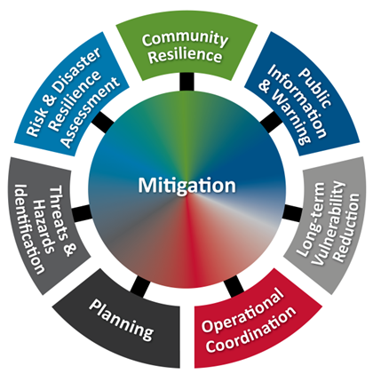
Mitigation
You should be aware of mitigation issues in your community
Learn the high-risk areas
Learn the existing or potential projects and how they are funded
Notes:
Mitigation is taking sustained actions to reduce the impact of natural hazards on people and property.
Mitigation activities can save lives and money.
This is being proactive versus reactive.
For example, maintaining strong building codes and enforcing them reduce property damage from storms, and
storm water management can minimize flooding risks.

Slide 11
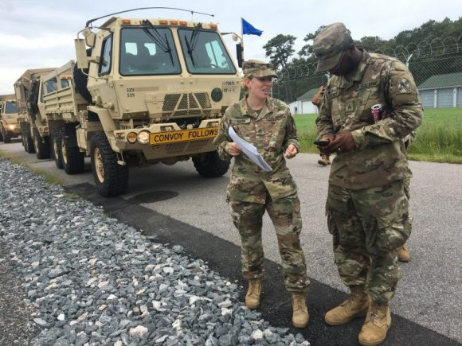
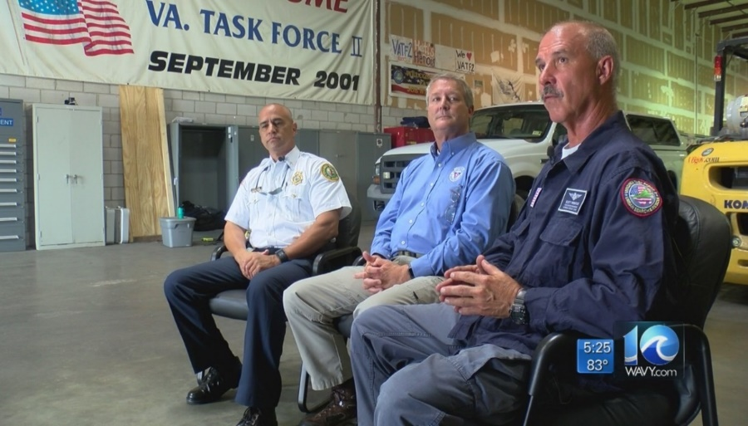
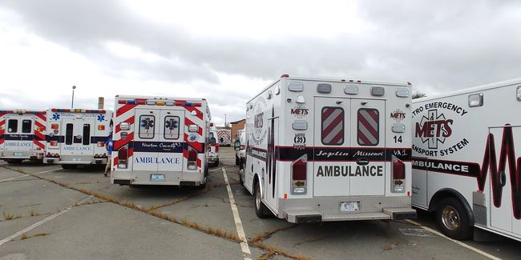
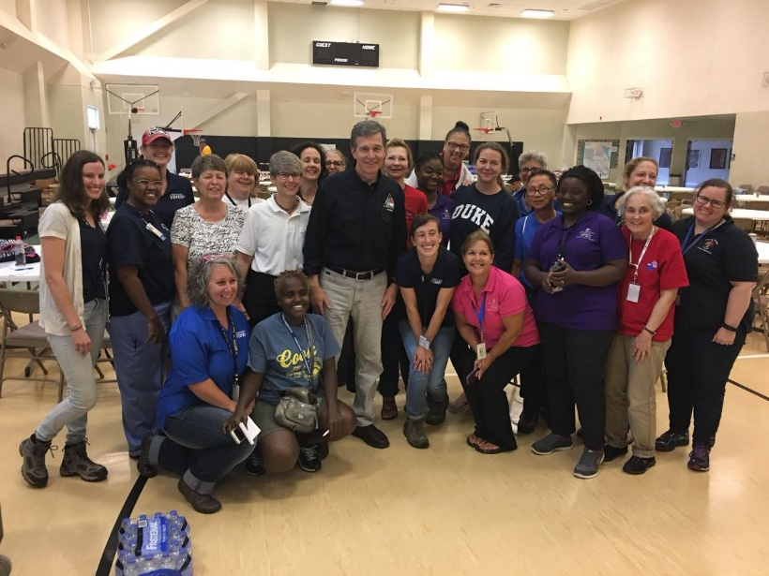
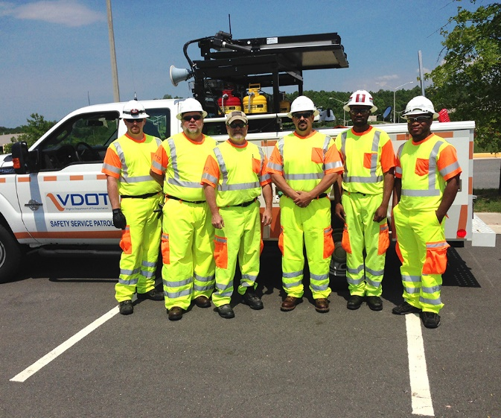
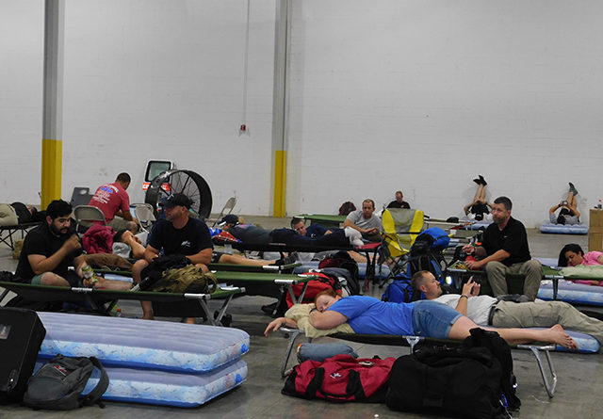
Response
This is what Response looks like
Notes:
The actions taken in the initial minutes of an emergency are critical. A prompt warning to employees to evacuate, shelter or lockdown can save lives. ... Lockdown is protective action when faced with an act of violence. When an emergency occurs, the first priority is always life safety.
The first step when developing an emergency response plan is to conduct a risk assessment to identify potential emergency scenarios. An understanding of what can happen will enable you to determine resource requirements and to develop plans and procedures to prepare your business.
When natural disasters and humanitarian crises strike, communities are often devastated and left vulnerable, having little access to some of life's essentials, such as food, clean water, shelter, and basic services.
Aggregate of decisions and measures taken to (1) contain or mitigate the effects of a disastrous event to prevent any further loss of life and/or property, (2) restore order in its immediate aftermath, and (3) reestablish normality through reconstruction and rehabilitation shortly thereafter.
Nurses from local hospitals for mass care
Shelter staff, VDEM Staff, The local volunteers for food, VDOT
Department of public works, Virginia National Guard, Search and Rescue teams, IMT’s, EMS, Fire, Police0

Slide 12
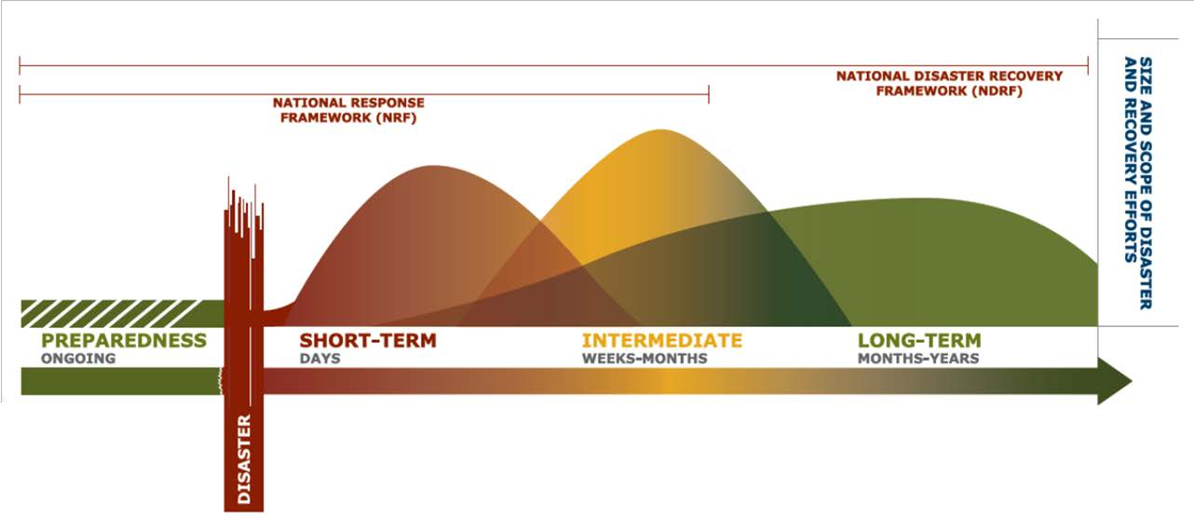
Recovery Continuum
Notes:
Short-Term is days
Intermediate is weeks to months
Long-term is months to years and will depend on the severitiy of the damage caused by the disaster
reality that, for a community faced with significant and widespread disaster impacts, preparedness, response, and recovery are not and cannot be separate and sequential efforts.
Laying an effective foundation for recovery outcomes is a key requirement of response activities, but planning for recovery begins before response. Community-level planning for recovery is a preparedness-phase activity that strengthens
continuity and response and hastens recovery.
An example is a major employer deciding to relocate rather than rebuild because it perceives that destroyed housing, roads, retail, and basic government services are not being restored and rebuilt timely and adequately. This outcome may have been avoided by including the
challenge is to ensure adequate and effective coordination between different efforts and players, as the decisions and outcomes for all phases are interconnected.
Bring Policy makers together to decide what our whole community looks like as an end result

Slide 13
Short & Interim Term Recovery
Assess housing impacts and pre/post disaster needs, identify available options for temporary housing, and support the local development plan for permanent housing
Facilitate the restoration of and sustain essential services to maintain community functionality
Implement measures to protect and stabilize natural resources and culturally significant documents, objects and structures
Notes:
Recovery involves all of the cleanup, repair and financial assistance needed to return an area back to pre-disaster conditions; it is one of the most challenging aspects of disasters and the most complex. It will take time and a community-wide effort to recover from a disaster.
Some residents may question the pace of the recovery effort or question why they are not seeing relief workers in their specific area. The priorities after a disaster are:
1. Life safety
2. Critical facilities (systems)
3. Private property damage
An elected official should receive regular briefings on the extent of damage and status of recovery process from the local Emergency managers
This will help you communicate with all those that need to know what help and support is needed and answer questions that could be asked
After initial response efforts, your community must determine the amount of damage.
Your locality must submit an initial damage assessment to the Virginia Emergency Operations Center, usually within 72 hours. I
If the damage appears significant, then a team of state and federal personnel may visit the area to perform additional assessment.
Recovery is not an isolated mission to be engaged only during post-disaster conditions. Complete recovery post-disaster involves the coordination and concurrent efforts of all mission areas. Through proper preparedness and activities pre-disaster, post-disaster recovery needs can be reduced, and recovery efforts can be accelerated, streamlined, and applied nationwide so that all communities, regardless of location and magnitude of incident, can recover post-disaster as efficiently as possible.
FEMA assists in community recovery through a number of channels, including obligating monetary aid for both individual assistance and public assistance.
Individual assistance (IA) to eligible survivors may include temporary or permanent housing, crisis counseling, legal services, disaster case management, and unemployment assistance, among other services. Disaster survivors who need information on programs for homeowners and renters should visit www.disasterassistance.gov.
Public Assistance (PA) may include reimbursement to clear debris and rebuild roads, schools, libraries, and other public facilities.FEMA's Public Assistance grant program provides federal assistance to government organizations and certain private nonprofit organizations following a Presidential disaster declaration.

Slide 14
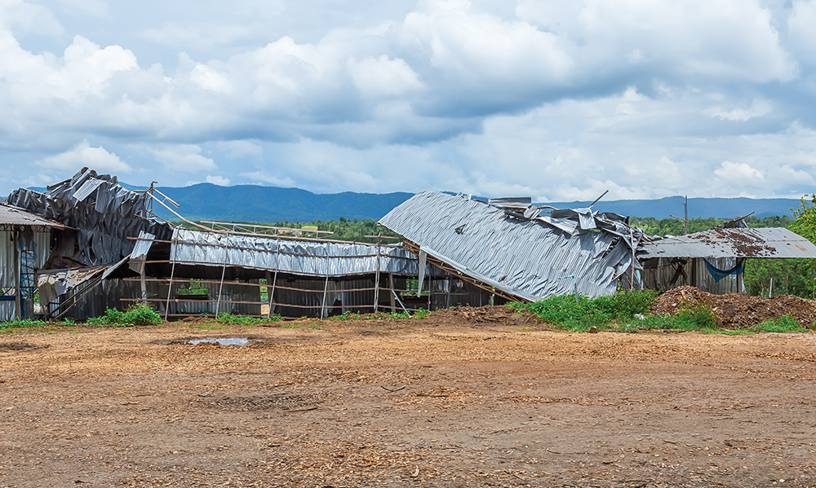
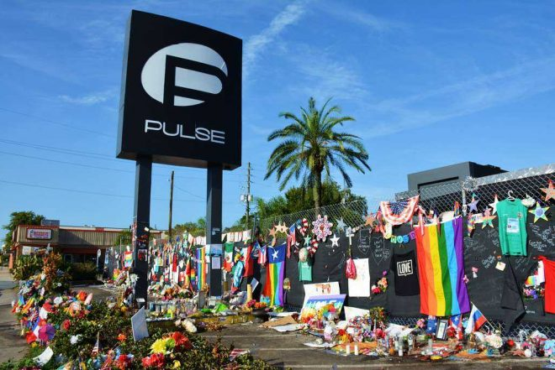
Long Term Recovery
Hurricane Katrina
August 23, 2005
Lower Ninth Ward
New Orleans, Louisiana
Pulse Night Club
July 12, 2016
Orlando Florida
Notes:
You can support response agencies and reassure the public by talking about:
1) Only what you know
2) What emergency responders and community leaders are doing
3) What the public can and should do
4) Positive things. Avoid focusing on problems -- it can have a negative effect on recovery efforts.
New Orleans after Hurricane Katrina- One is a thriving, vibrant attraction for tourists who have returned in full force, awed by booming neighborhoods that look even more beautiful than before the floodwaters submerged 80 percent of the city and killed nearly a thousand residents.
The other is epitomized by enclaves like the Lower Ninth Ward, where the recovery has meant returning to pre-hurricane levels of poverty and violent crime. Where half of the population still hasn’t returned. Where tens of thousands of abandoned homes have been left to rot in the humid air.
more sustainable solutions, such as finding housing, reviving local businesses, and fixing infrastructure. Meeting these long-term needs is critical to the full recovery of impacted communities.
A victims' assistance center, Orlando Family Assistance Center, was opened on June 15 inside Camping World Stadium by the City of Orlando.^{[167][168]} During the eight days it was open, it provided help to 956 people from 298 families. Those remaining were then directed to the newly opened Orlando United Assistance Center jointly set up by the City and Orange County, which, according to the mayor of Orlando, "will stay open as long as there is a need".^{[169][170]}
The two hospitals that treated Pulse victims, Orlando Regional Medical Center and Florida Hospital, announced in late August that they will not be billing the survivors or pursuing reimbursement.^{[171][172]}
The City of Orlando offered free plots and funeral service at the city-owned Greenwood Cemetery for those killed in the shooting
A total of 603 calls to 9-1-1 were made by victims, family members and friends of victims, bystanders, and rescue workers during the entire shooting.

Slide 15
Chief Regional Coordinators
Lori Dachille- Region 1
10501 Trade Court Richmond, VA 23236
Lori.Dachille@vdem.Virginia.gov
804-314-0803 (Cell)
Tim Estes- Region 4
225 State Street Marion, VA 24354
William.Richardson@vdem.Virginia.gov
804-516-5771 (Cell)
Mark Stone- Region 2
13206 Lovers Lane
Culpeper, VA 22701
Mark.stone@vdem.virignia.gov
804-774-9271 (Cell)
Bruce Sterling- Region 5
1070 University Blvd. Portsmouth, VA 23703
Bruce.sterling@vdem.Virginia.gov
804-516-5786 (Cell)
Gene Stewart- Region 3
P.O. Box 298 Harrisonburg, Va. 22803
Gene.stewart@vdem.virignia.gov
540-383-5126 (Cell)
Mike Pruitt- Region 6
4504 Starkey Road, Suite 100 Roanoke, VA 24018
Michael.Pruitt@vdem.Virginia.gov
804-774-8796 (Cell)
Andy John- Region 7
475 Alliance Drive 4E, Suite 200 Fairfax, VA 22030
Andy.john@vdem.virginia.gov
804-624-8327 (Cell)
Notes:
Each region has a VDEM Chief regional coordinator, planner and DRRO (disaster recovery and resilience officer)
When working with VDEM at the local level these are the contacts you should be working through during your disaster
Lori Dachille from Region 1 will be joining us shortly for our panel discussion to discuss more of the interactions of our regional staff with our locals.

Slide 16
Emergency Numbers
State Police
804-674-2000
Virginia Emergency Operations Center
804-674-2400
800-468-8892
VDEM Director of Public Affairs
804-897-6510
Virginia Department of Health
866-531-3068
VDOT
511
National Human Trafficking Hotline
1-888-373-7888
Notes:
Some important numbers you can include in you reference guides:
Virginia State Police
804-674-2000
Virginia Emergency Operations Center
804-674-2400 or 800-468-8892
VDEM Director of Public Affairs
804-897-6510
Virginia Department of Health
866-531-3068
VDOT
511
So now we will hear from Allison Farole, Ablemarle’s Emergency Coordinator. She will discuss with you lessons learned from Charlottesville and Ablemarle with last year’s events.

Slide 17
Case Study: Charlottesville/Albemarle August 2018
Notes:
So now we will hear from Allison Farole, Ablemarle’s Emergency Coordinator. She will discuss with you lessons learned from Charlottesville and Ablemarle with last year’s event.

Slide 18
Case Study: Charlottesville/Albemarle August 2018
Utilized lessons learned from August 2017
Regional Emergency Operations Plan and Emergency Operations Center
Charlottesville-UVA-Albemarle
Offered G-402 ICS Overview for Executive/Senior and Elected Officials
Staggered 2-hour sessions for City Council
Provided 1-hour long workshop at Board of Supervisors meeting
Developed a locally-focused Elected Official Guide for disasters
Provided tour of EOC prior to Command Center Activation
FINAL RESULT?
Notes:
Review lessons learned
Mayor at EOC
Uncoordinated press interviews
No single message
No discreet lines of communications
Three jurisdictions provide an unique balance of politics
Needed to develop a training opportunity that fit into busy schedules, didn’t force a public meeting, and provide a safe space for discussion
Various needs for each elected body
Offered a glimpse of what the EOC/JIC looked liked and provide 30 minute tours and descriptions of how the 402 training is utilized in these elements
Results: 1. Clear lines of communication, identified and implemented proper roles/responsibilities, single message amongst all three jurisdictions

Slide 19
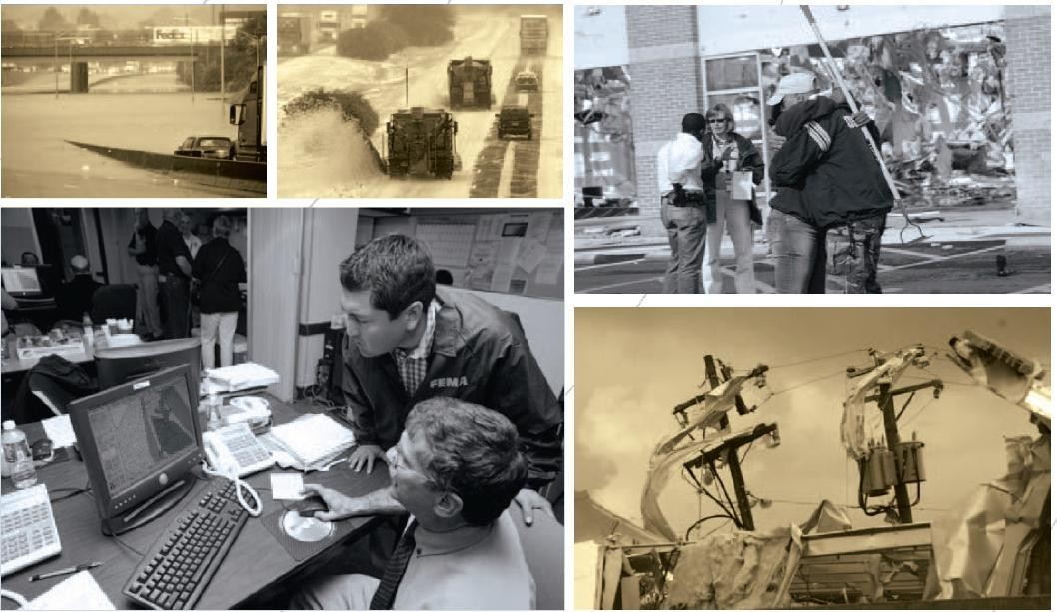
Charlottesville-UVA-Albemarle County
Elected Official and Executive Staff’s Guide to Emergencies and Disasters

Slide 20
Panel Discussion
Jeff Caldwell- Director of External Affairs
Lori Dachille- Chief Regional Coordinator, Region 1
Shannon Daniel- State Training Officer
Allison Farole- EM Coordinator, Charlottesville/UVA/Albemarle County
Dillon Taylor- Assistant Director of External Affairs, Policy

Slide 21
http://www.vaemergency.gov/prepare-recover/threats/

