Slide 1
Virginia Conflict of Interest Act
How to Avoid Dilemmas
Sharon E. Pandak
Greehan, Taves & Pandak, _{PLLC}
_{spandak@gtpslaw.com}
VML Annual Conference October 1, 2018, Hampton, VA.
WHAT TO DO? WHAT TO DO?

Slide 2



You are required to read COIA upon assuming office
Don’t understand or want to ignore the implications of the COIA?
Let’s play – Guess which door?

Slide 3

You are a bright, progressive, elected official.
No old doors…

Slide 4

Pick one of these Special COIA Event Doors

Slide 5



The Category is: “I am too busy”:
File the annual economic interests form late (after February 1)
Ignore COIA because you are not elected but are a member of the EDA or certain other authorities; citizen member of Boards/Commissions set by ordinance/resolution (ex. PC, BZA);“Person Occupying Position of Trust”designated by ordinance or School Board policy – ex. Chief Administrative Officer; Local Govt Attorney.
Fail to provide the Clerk with a written disclosure of a conflict or disqualification
Pick Door C

Slide 6


Other “I am too busy” events:
Fail to provide legal counsel all of the relevant facts when asking about a possible conflict
Fail to advise legal counsel of conflict questions until just before a vote - ask in the midst of a meeting
Continue discussing a matter in which you have disqualified yourself
Fail to identify “personal interests” of persons in your household as part of your “personal interest”
Fail to follow the requirements for reporting if you accept tickets to a _________________

Slide 7





You pay -
$250 fine for late filing
potential fine for violation of disclosure provision
and
You lose political credibility for your tardiness

Slide 8

The Category is: “I know what I am doing”
Pick Door C

Slide 9



Slide 10
The Category is “I am Gifted”:
  Constituents want to acknowledge my help with presents
  I am invited to so many dinners, I must enjoy their offers of tickets
  I am asked to find jobs or provide “inside” information for supporters
  People acknowledge the burden of service on my family by helping them out
Pick Door A (yes, again)

Slide 11
But before you open the door, consider:
“Personal Interest” =
> $5,000 in income, compensation, fringe or other benefits annually;
Ownership of real or personal property if the interest is > $5,000, exclusive of other ownership in a business, income or benefits from the property;
Personal liability on behalf of a business > 3% of the business’ asset value; or
An option for ownership of a business or real or personal property if the interest is > 3% or > $5,000 in a contract or transaction.

Slide 12
Additional Examples:
Debts to creditors of > $5000.
Interests in rental property of > $5000.
Payments for representation by you or your associates of > $5000
Payments for services from businesses which operate in Virginia of > $5000

Slide 13







Additional Examples:
Combined Payment for each
  Talk,
  Meeting,
  …. of more than $100

Slide 14

Gift Issues !!!!!
Is it a Gift?
Is it prohibited?
Reporting requirements for certain gifts
Thresholds

Slide 15



GIFTS for which you neither paid nor rendered services in exchange:
Combination of Gift or entertainment of more than $50 in value*
[Gifts of >$100 each or in aggregate from any lobbyist or who is seeking to contract w/ your county are PROHIBITED. (Gifts <$20 not subject to aggregation here)*

Slide 16


You claim COIA does not understand the demands on local politicians

Slide 17
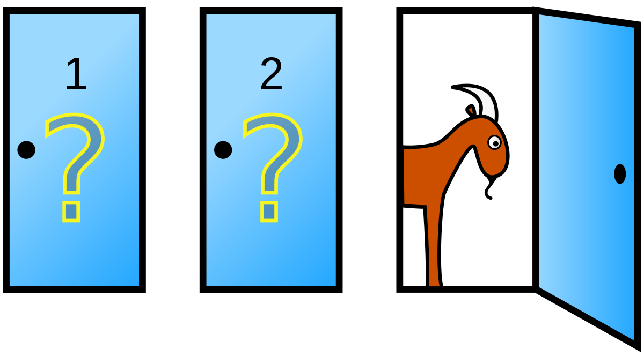

Slide 18
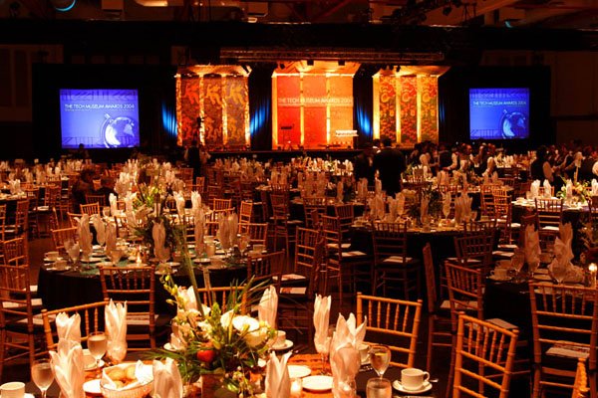
The “Widely Attended Event”
EXCEPTION (§2.2-3103.1)
“an event at which at least 25 persons have been invited to attend or there is a reasonable expectation that at least 25 persons will attend the event and the event is open to individuals (i) who are members of a public, civic, charitable, or professional organization, (ii) who are from a particular industry or profession, or (iii) who represent persons interested in a particular issue.”
You can accept or receive a gift of food and beverages, entertainment, or the cost of admission >$100 while in attendance but must report on disclosure form.

Slide 19


The “APPROVED IN ADVANCE” EXCEPTION (§2.2-3103.1)
MUST make a request of Council and MUST receive Approval of Council

Slide 20


How to handle the appearance of a conflict?
Ignore concerns being raised - “ride it out”
Avoid interaction with your local gov’t attorney
  or Commonwealth’s Attorney
Tell accusers to “bring it on”
Ask the State Police for an investigation
Claim the matter is too personal to discuss
Ask your other council members under “bonds of secrecy”
Call your mother

Slide 21


Or
Say it ain’t so.

Slide 22

OR
Ask for opinion from local gov’t atty, Commonwealth’s Atty, COIA Council/staff promptly
Announce determination of no-conflict in a “thoughtful way” which might include:
    sharing that you asked for an opinion or have attorney state this
    sharing the opinion publicly and appropriately
    provide disclosure that you can participate fairly, objectively and in the public interest

Slide 23
Don’t want to pick a door without calling a
“life line”?
aka Resoources:
Your City/Town/County Attorney,
Your Commonwealth’s Attorney
or
the COIA & Ethics Advisory Council staff
Hotline
Call

Slide 24
Resoources:
G. Stewart Petoe
Executive Director
Email: spetoe@dls.virginia.gov
Phone: 804-698-1845
Elizabeth Sundberg
Filing Coordinator
Email: esundberg@dls.virginia.gov
Phone: 804-698-1848
Rebekah Stefanski
Attorney
Email: rstefanski@dls.virginia.gov
Phone: 804-698-1846
Valerie Mizzell
Assistant
Email: vmizzell@dls.virginia.gov
Phone: 804-698-1847
General Staff Contact
Email: ethics@dls.virginia.gov
Mailing Address:
900 East Main Street, 8th Floor
Richmond, Virginia 23219
COI & Ethics Advisory Council staff

Slide 25
http://ethics.dls.virginia.gov
In-person training is available from Council staff upon request as the staff schedule permits at no cost to your agency.

Slide 26

Pick Door C

Slide 27

YAY!!!
You have:
  Peace of mind
  Credibility
  Can focus on your role as a public servant

Slide 28

With deference and respect to “Let’s Make a Deal” and “Jeopardy.”
Presentation has been taken from prior presentations to VACo and LGA.
The presenter disclaims that she is providing individual legal advice or speaking in her role as a member of the Virginia Conflict of Interests Advisory & Ethics Council, or on behalf of any client.

