Slide 1
GO VA “Journey”
VML Community & Economic Development Committee Meeting
James W. Noel, Jr., Director
York County Economic Development
July 18, 2019

Slide 2
Early Journey
Peninsula Economic Resource Team (PERT) meets Fall 2017 to develop Go VA grant ideas
RIFA/Unmanned Systems Project Go VA grant awarded February 2018
EVRIFA officially formed December 18, 2018
Unmanned Systems Testing & Demonstration Facility A&E RFP issued December 2018
www.EVRIFA.org

Slide 3
RIFA
Regional Industrial Facility Authority (RIFA)
State code for RIFAs allows cost and revenue sharing for economic development projects
RIFA will be utilized for additional regional economic development initiatives
RIFA legislation allows member localities to choose which projects they will participate in
Open for others to join in future
www.EVRIFA.org

Slide 4
USTDF
“Fly Zone” (testing & demonstration area) 192 acres
Long term ground lease
Class G Uncontrolled Air Space
Clear nine (9) acre test area and construct testing pavilion
Light Industrial Park – 240 acres
Extend infrastructure and construct a 10,000 sq. ft. flex space building
Facility Manager’s office & co-working space for companies, higher-ed and federal agencies
www.EVRIFA.org

Slide 5
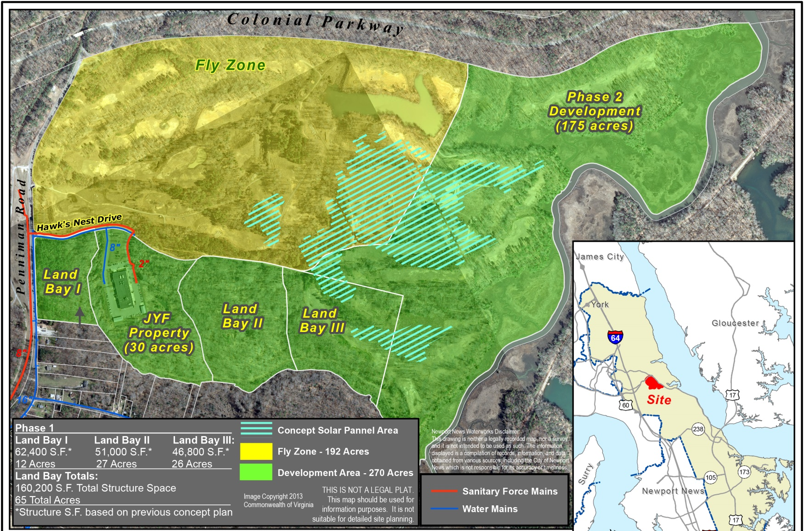
Development Plan

Slide 6
USTDF Project Justification
Within Region 5, Unmanned Systems cluster has the highest average annual wages - $86,840
Significant regional assets exist to support and grow this cluster: NASA, NIA, VIMS, ReAKTOR, ODU, W&M
Lack of testing/demonstration areas in Hampton Roads is an industry identified impediment to growth
Opportunity to foster economic growth through a regional cost and revenue sharing agreement (RIFA)
Public Private Partnership to facilitate development of 432 acres of surplus state property
www.EVRIFA.org

Slide 7
USTDF Grant Award
$300,000 ($150K GO VA - $150K local match)
$25k Regional Industrial Facility Authority (RIFA) formation
$275k A&E work for testing area, testing pavilion, and 10k sq. ft. flex space building
Participating localities: Six Peninsula jurisdictions and Gloucester
Gloucester participation will allow future grant requests to State GO VA funding pool
Plan to apply for additional GO VA funds for future land development and facility construction
www.EVRIFA.org

Slide 8
EVRIFA Status
Journey Launched before Charting the Course
Isle of Wight BOS approved EVRIFA membership
Chesapeake City Council received EVRIFA briefing
State approved a grant modification in June 2019 to assist with EVRIFA development
EVRIFA Challenge: No immediate ROI from USTDF project
www.EVRIFA.org

Slide 9
Fork in the Road
KDC Solar
Interested in developing 20MW facility on 150-200 acres of the site
A&E process suspended, pending land control resolution
General Assembly
Budget amendment HB1700, approved during 2019 General Assembly session, provides path for land acquisition by end of 2019
Working with DGS, KDC, and EVRIFA to solve land sale issue
www.EVRIFA.org

Slide 10
The Journey continues….
www.EVRIFA.org

